Slide 1
Veridian Corp
AI IT Support Agent
Nishant Rajora
23csu220
Working Prototype
AI Core
Full-stack web application with Support, My Tickets and Admin views.
Ollama + gpt-oss:20b with classify → retrieve → decide → respond.
AIONOS Recruitment — Assignment 2
01

Slide 2
Problem & Objective
Internal IT support requests require consistent policy handling, triage and escalation.
The support problem
What the agent does
Design objectives
Employees raise repetitive requests across access, hardware, software, email, printers and security. The prototype focuses on first-line handling while preserving a path to human review.
• Classifies the request into an IT category
• Retrieves the relevant company policy
• Uses historical tickets as precedent
• Decides: resolve, follow up or create a ticket
• Generates an employee-facing response
• Ground responses in the provided policy set
• Automate simple self-service guidance
• Route cases requiring human action
• Persist tickets and audit information
• Provide an accessible browser prototype
02

Slide 3

Solution Overview
A grounded AI support agent connects the employee UI, policy knowledge and ticket workflow.
Decision
Employee
Request
FastAPI
Controller
AI Agent
agent.py
Policy
Retriever
Response
Ticket / Human
Review
Grounding
Reasoning
Persistence
policies.json is the policy source; retrieval uses category mapping and keyword scoring.
Ollama gpt-oss:20b handles classification, decision and response generation.
SQLite stores tickets, audit logs and settings; admins can update ticket status.
03

Slide 4
Complete Solution Architecture
Actual project components and their responsibilities.
FRONTEND • static/index.html | script.js | style.css
BACKEND • main.py / FastAPI + Uvicorn
AI ORCHESTRATION
agent.py
classify → decide → respond
KNOWLEDGE
retriever.py
policies.json
PERSISTENCE
database.py
SQLite
LLM
Security
Audit
Ollama API → gpt-oss:20b
bcrypt + Bearer admin sessions
audit_logs records request processing
04

Slide 5
Agent Workflow & Decision Logic
The agent follows a structured pipeline designed around policy grounding.
1
Classify
2
Retrieve
3
Decide
4
Act
5
Respond
classify_request()
LLM → IT category
find_relevant_policy()
Category map → keyword score
make_decision()
Policy + request + history
Resolve / follow-up /
create ticket
generate_response()
Employee-facing message
Self-service example
Approval example
Security example
Guest Wi-Fi → KB-07 → no ticket; use front-desk kiosk.
Contractor VPN → KB-02 → manager approval → ticket/human path.
Phishing → KB-09 → immediate Security escalation + ticket.
05

Slide 6
Inputs, Sources & Assumptions
The implementation separates employee input from grounded policy and historical context.
Inputs
Sources
Grounding approach
• Employee name
• Employee email
• Free-text support request
• Admin password for admin login
• Policy data
• Historical ticket context
policies.json
Official IT policy knowledge base
veridian_it.db
Tickets, audit logs, settings
tickets.json
Historical tickets seeded into SQLite
Ollama
gpt-oss:20b runtime model
1. Category → policy mapping
2. Keyword scoring fallback
3. Retrieved policy becomes decision context
4. Historical tickets provide precedent
5. LLM outputs structured JSON for decisioning
Implementation assumption: Ollama is available at the configured runtime endpoint; secrets are kept in environment configuration.
06

Slide 7
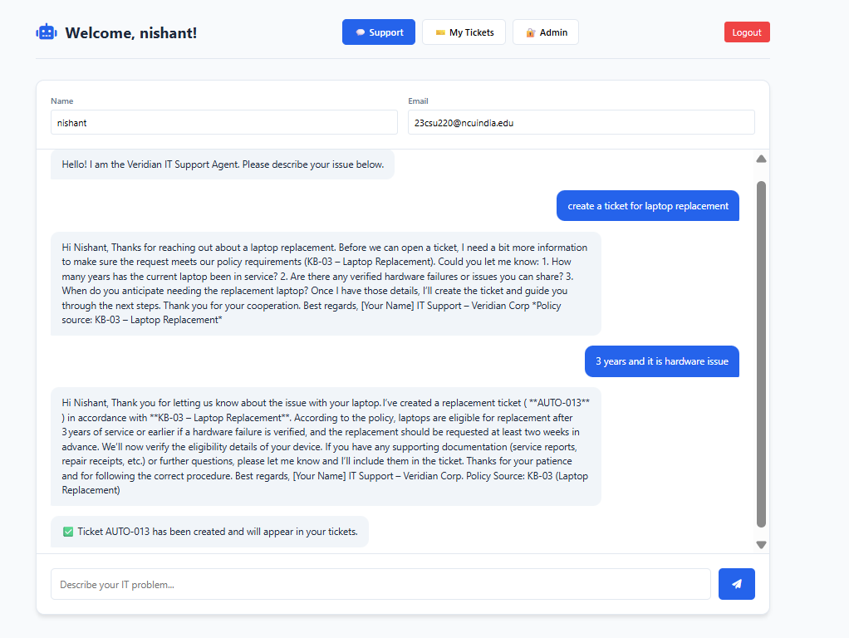
APIs & Automated Raise-Ticket Workflow
Frontend requests are routed through FastAPI; the agent can create a persistent ticket when needed.
User
Submit request
script.js
POST request
agent.py
needs_ticket
database.py
create_ticket()
Implemented API surface
POST /api/support/request Submit employee issue
GET /api/support/my-tickets Fetch employee tickets
POST /api/admin/login Admin authentication
GET /api/support/tickets Admin ticket view
PATCH /api/support/tickets/{id} Update ticket status
GET /api/support/audit View audit logs
GET /api/support/policies View knowledge base
07

Slide 8
AI Tools & Technology Stack
Runtime AI is intentionally simple: one LLM plus policy retrieval and structured prompting.
Ollama
gpt-oss:20b
RAG pattern
AI usage
LLM runtime
/api/generate
Classification
Decision
Response
Policy grounding
via policies.json
Classification
Decision reasoning
Response generation
JSON-formatted outputs
Policy context supplied to the model
FastAPI
SQLite
bcrypt
REST backend
request routing
Tickets
Audit logs
Settings
Admin password
hashing
08

Slide 9
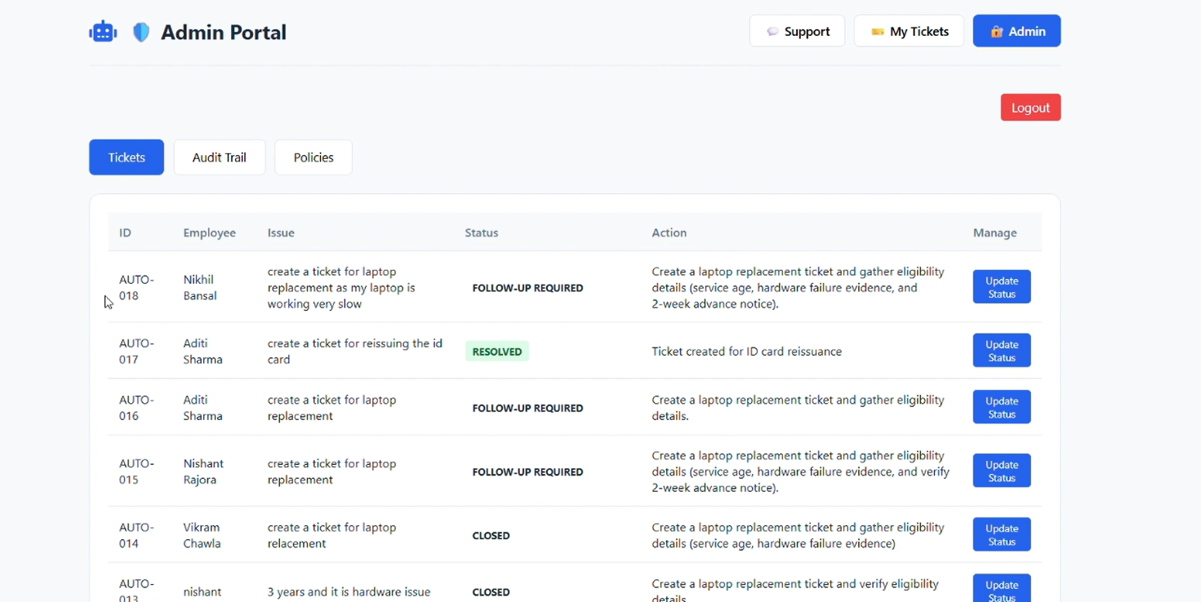
Admin Panel
09

Slide 10
Implementation Summary
A compact, testable IT support agent with grounded policy retrieval and auditable ticket handling.
WORKING AGENT
GROUNDED SOURCES
AUTOMATED TICKETING
HUMAN OVERSIGHT
Classify → retrieve → decide → respond
policies.json + historical ticket context
needs_ticket → SQLite AUTO-XXX ticket
Admin dashboard + status updates + audit logs
Assignment coverage
Core implementation
✓ Working/clickable prototype
✓ Architecture & process flow
✓ Inputs, sources & assumptions
✓ AI tools and how they are used
Frontend: HTML/CSS/JS
Backend: FastAPI
AI: Ollama + gpt-oss:20b
Data: policies.json + SQLite
Security: bcrypt + Bearer admin sessions
Key principle: policy-grounded automation with a clear route to human review.
10

